Slide 1


DCS Compendium
Created by: Hayden Sexton

Slide 2
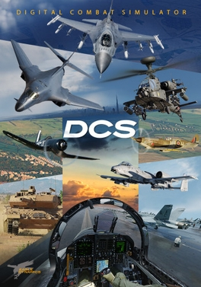
Background of DCS
Realistic Flight Sim
1:1 from Real-Life
Massive Maps
Combat
Training
Complex lessons

Slide 3
Why did I feel like building the DCS Compendium?
Repetition helps learn
Enjoy what you're making it for = enjoy making the project
Help new players

Slide 4
So, what is the point of the DCS Compendium?
Provides quick info
Simple to understand
Helps new and returning players

Slide 5
Similar apps/websites to the dcs compendium
Hoggitworld.wiki – offers numbered table of contents and more info + techniques
Armadainternational.com – offers brief info on military vehicles, normally makes military articles

Slide 6
What is special about the DCS Compendium?
No app like it
Allows only the creator to perform CRUD
Many entries that include detailed info on vehicles

Slide 7

Features of the application
CRUD Features
Admin login to prevent unwanted creators
Clickable and image-based interface
Smart search
Easy to navigate

Slide 8

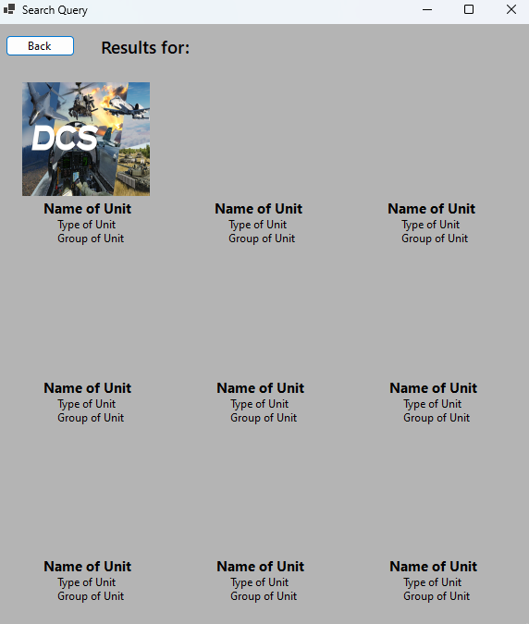
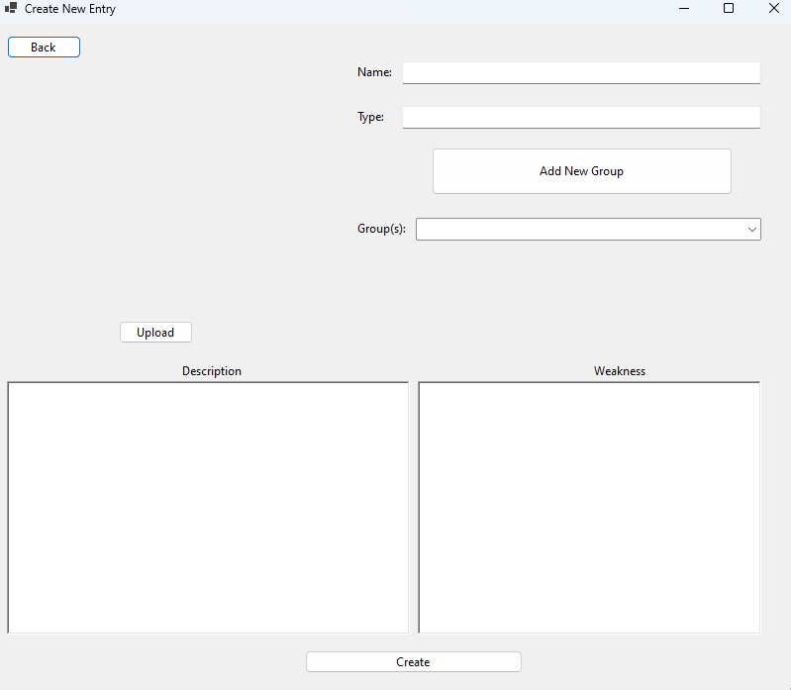
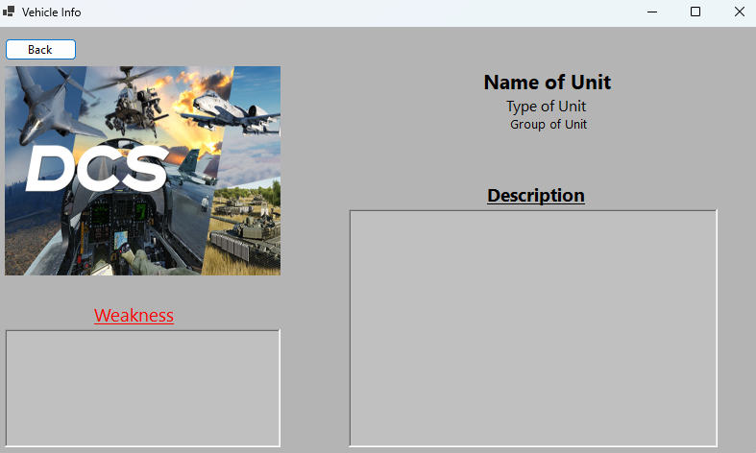
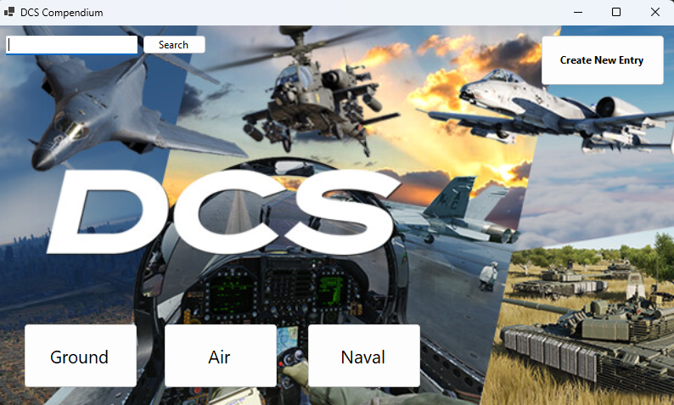
Live Demo

